Slide 1
Advanced Computer Architecture Group
Processor Architectures
Neural Network
Computer Vision
Machine Learning
Parallel Architectures
Hang Dai

Slide 2
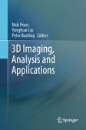
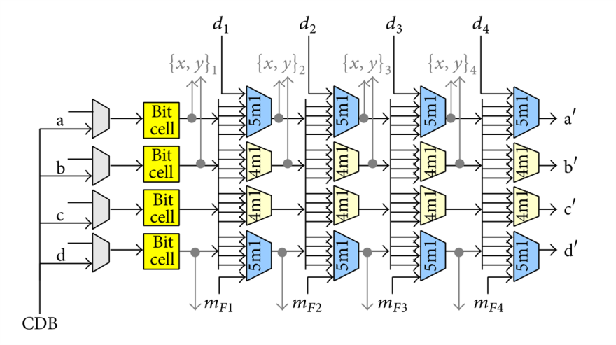
Research Projects
[1] The Liverpool-York Head Model
Sponsors:
Google, via their Faculty Research Awards Programme : Headspace Online (2017-18)
The Royal Academy of Engineering and Leverhulme Trust
QIDIS for supporting the Headspace project at Alder Hey, 2013
The University of York Centre for Chronic Diseases and Disorders (C2D2, Wellcome Trust supported), Research Priming Fund
[2] Bailey, C. and Mullane, B. (2014). Investigation of a Superscalar Operand Stack Using FO4 and ASIC Wire-Delay Metrics. VLSI Design, 2014, pp.1-13.

Slide 3
Recent publications
1. Symmetric Shape Morphing for 3D Face and Head Modelling
H. Dai, N. E. Pears, W. Smith and C. Duncan. Proc. 2018 IEEE Int. Conf. Automatic Face and Gesture Recognition (FG 2018)
2. A Data-augmented 3D Morphable Model of the Ear
H. Dai, N. E. Pears, W. Smith and C. Duncan. Proc. 2018 IEEE Int. Conf. Automatic Face and Gesture Recognition (FG 2018) 3. A 3D Morphable Model of Craniofacial Shape and Texture Variation
H. Dai, N. E. Pears, W. Smith and C. Duncan. Proc. 2017 Int. Conf. Computer Vision (ICCV 2017) 4. Symmetry-factored Statistical Modelling of Craniofacial Shape
H. Dai, W. Smith, N. E. Pears, and C. Duncan. Proc. 2017 PeopleCap Workshop, Int. Conf. Computer Vision (ICCV 2017) pp. 786-794 5. Modelling of Orthogonal Craniofacial Profiles
H. Dai, N. E. Pears and C. Duncan. Journal of Imaging, vol 3, number 55 (2017) 6. A 2D Morphable Model of Craniofacial Profile and Its Application to Craniosynostosis
H. Dai, N. E. Pears and C. Duncan. Proc. 2017 Conf. Medical Image Understanding and Analysis (MIUA 2017). 7. A Morphable Model Of the Human Head Vaidating the Outcomes of An Age-Dependant Scaphocephaly Correction
B. Robertson, H. Dai, N. E. Pears and C. Duncan. Abstract in International Journal of Oral and Maxillofacial Surgery (vol 46, p68, 2017).
8. Functional Faces: Groupwise Dense Correspondence using Functional Maps
C. Zhang, W. Smith, A. Dessein, N. E. Pears, and H. Dai. Proc. 2016 Int. Conf. Computer Vision and Pattern Recognition (CVPR 2016) 9. A Morphable Profile Model of the Human Head as an Outcome Tool for Craniosynostosis Surgery
Christian Duncan, Rachel Armstrong (Alder Hey Hospital, Liverpool) and Nick E. Pears 16th Biennial Congress of the International Society of Craniofacial Surgery (ISCFS), Tokyo Bay, Japan, September 14th - 18th, 2015.
10. Evaluating a Miniature Multisensor Biosignal Recorder for Unsupervised Parkinson’s Disease Monitoring
Chris BAILEY, Jim AUSTIN, Garry HOLLIER, Anthony MOULDS, Michael FREEMAN, Alex FARGUS, Tom LAMPERT, Sensors & Transducers Journal, Vol. 184, Issue 1, January 2015, pp. 66-76
11. Investigation of a Superscalar Operand Stack Using FO4 and ASIC Wire-Delay Metrics
Bailey, Christopher, and Brendan Mullane, VLSI Design 2014 (2014).
12. A Miniature Multisensor Biosignal Data Recorder and its Evaluation for Unsupervised Parkinson’s Disease Data Collection
Bailey C, Hollier G, Austin J, et al, SENSORDEVICES 2014 : The Fifth International Conference on Sensor Device Technologies and Applications, ISBN: 978-1-61208-375-9, pp 84-92.(2014)
13. A Miniaturized 4-Channel, 2KSa/sec Biosignal Data Recorder With 3-Axis Accelerometer and Infra-red Timestamp Function
Jim Austin, Chris Bailey, Anthony Moulds, Garry Hollier, Michael Freeman, Gernot Riedel, Alex Fargus, Thomas Lampert, Bettina Platt, Proceedings of Sensorcom2013, Barcelona August 2013. ISBN: 978-1-61208-296-7, Pages: 213 to 219
14. A Time-Domain Based Lossless Data Compression Technique for Wireless Wearable Biometric Devices
Chengliang Dai and Christopher Bailey, Proceedings of Sensorcom2013, Barcelona August 2013. ISBN: 978-1-61208-296-7, Pages: 104-107

Slide 4
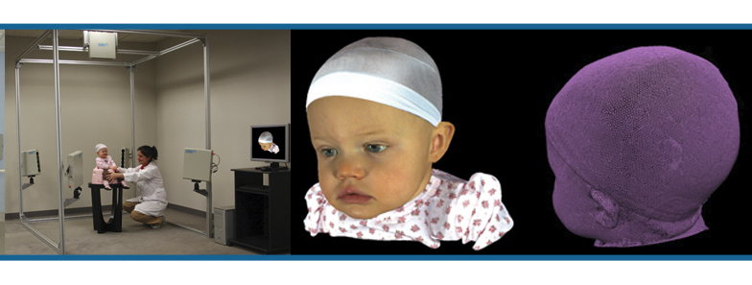
The Headspace Dataset from Alder Hey Hospital
Each of 5 3D camera units uses a combination of structured IR projection,
IR cameras and standard cameras (triangulation, like stereo).

Slide 5
3D Image Example: Christian Duncan, Alder Hey

Slide 6
3D Morphable Models

Slide 7
Age Regression

Slide 8
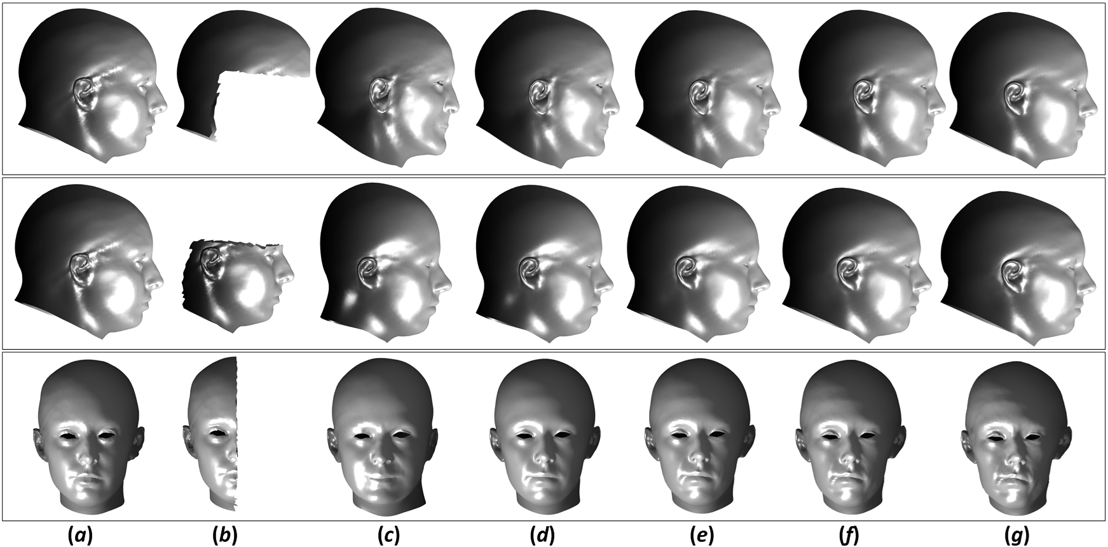
Flexibility of reconstruction from incomplete data
sample incomplete data
flexibility of reconstruction

Slide 9
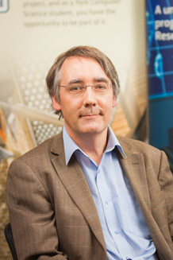
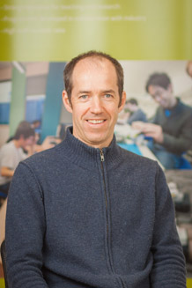
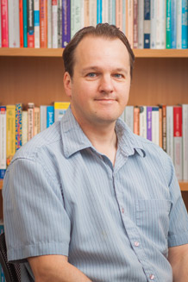
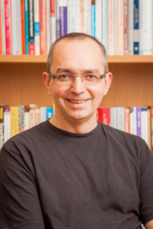
Academics
Computer Vision Machine Learning
3D Imaging
3D Shape Analysis
Processor Architecture
Stack Processor
Neural Network
Neural Networks

Slide 10
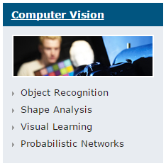
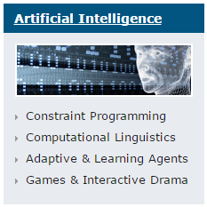
Ongoing Collaboration

